Slide 1
NAAN MUDHAALAVAN FUNDAMETALS OF DATA ANALYTICS WITH TABLEAU PROJECT TITLE: INDIA’S AGRICULTURAL CROP PRODUCTION ANALYSIS(1997-2021)

Slide 2
TEAM ID:NM2023TMID16177
TEAM LEAD ID:
041D8C9C0F9B083850843A0D5310924C
TEAM MEMBERS ID:
6E43EB36C99743690C44F99F8356CA6E
E99FAA47CAE0F508C1146C85D47007B3
3679E57F88AE7A486164E597EB3145F5

Slide 3
INTRODUCTION:
This report delves into the captivating realm of India’s agricultural cultivation, providing a comprehensive visual exploration of key aspects and trends in the agricultural sector. Through the visual representations , readers can gain valuable insights into crop production , seasonal variations, regional distribution, and over all production trends . These visualizations enable intuitive analysis, allowing stakeholders to uncover patterns , identify areas of growth or concern, and make date-driven decisions.
By harnessing the power of tableau ,this report not only presents the data in a visually appealing manner but provides an interactive experience for readers to explore the intricacies of India’s agricultural cultivation . To extract the insights from the data and put the data in the from of visualizations, dashboards tory we employed tableau tool.

Slide 4
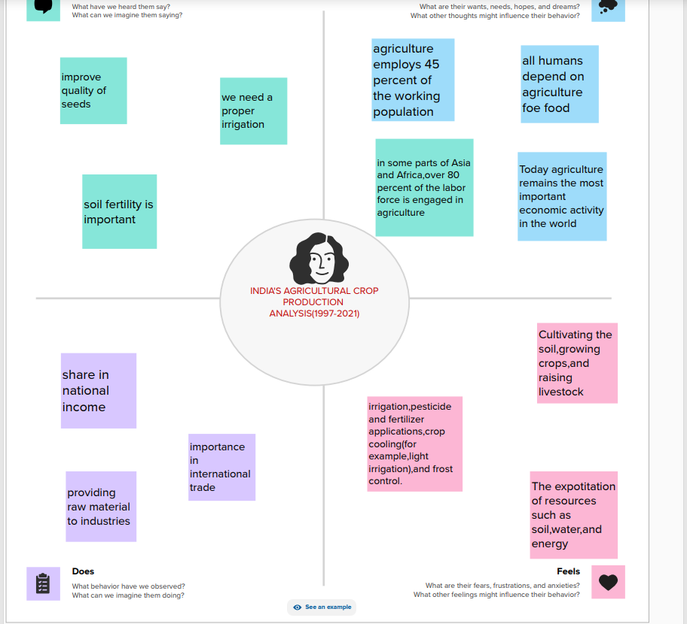
Empathy map

Slide 5
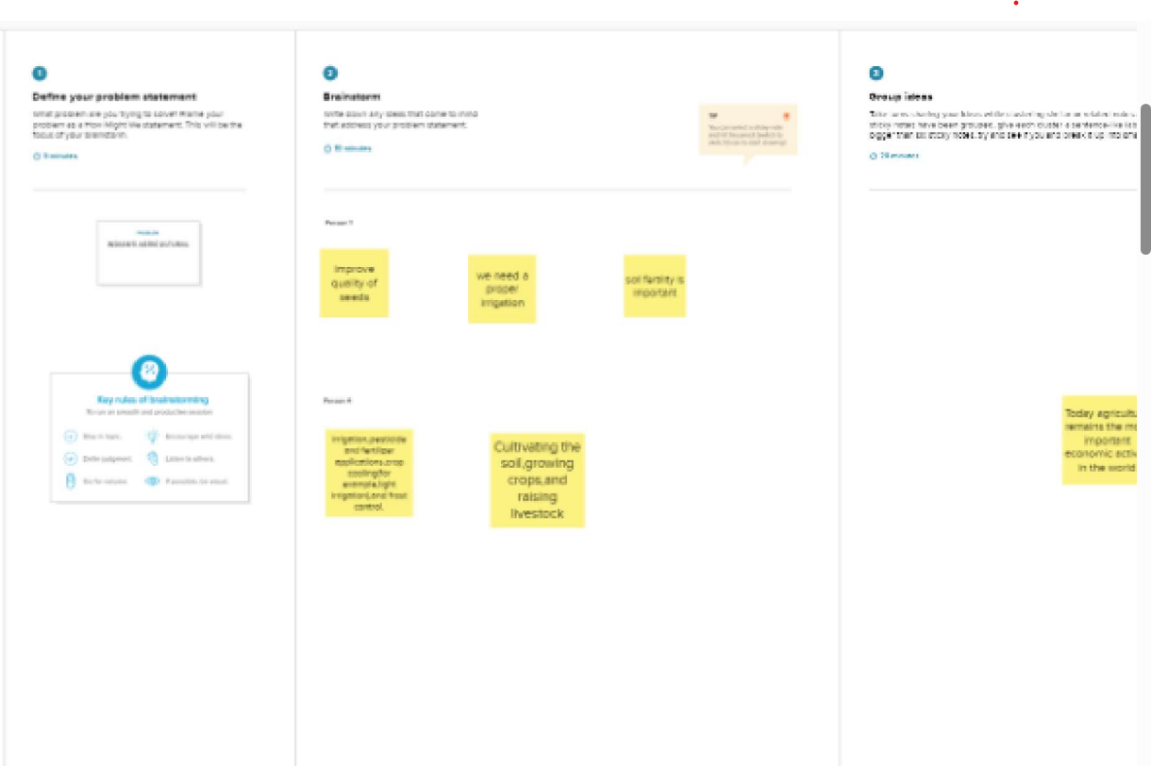
Brainstorm map

Slide 6
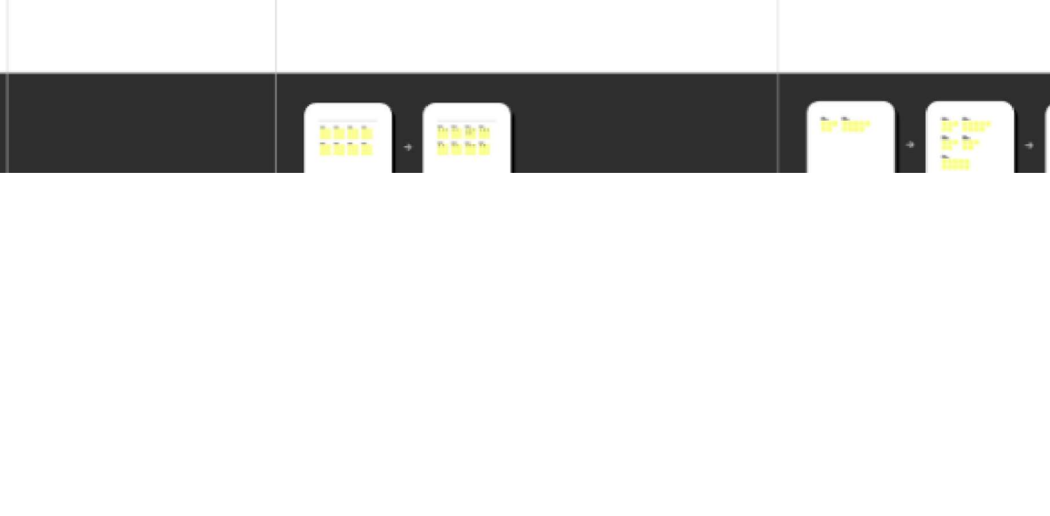

Slide 7
Result:
Data visualization

Slide 8
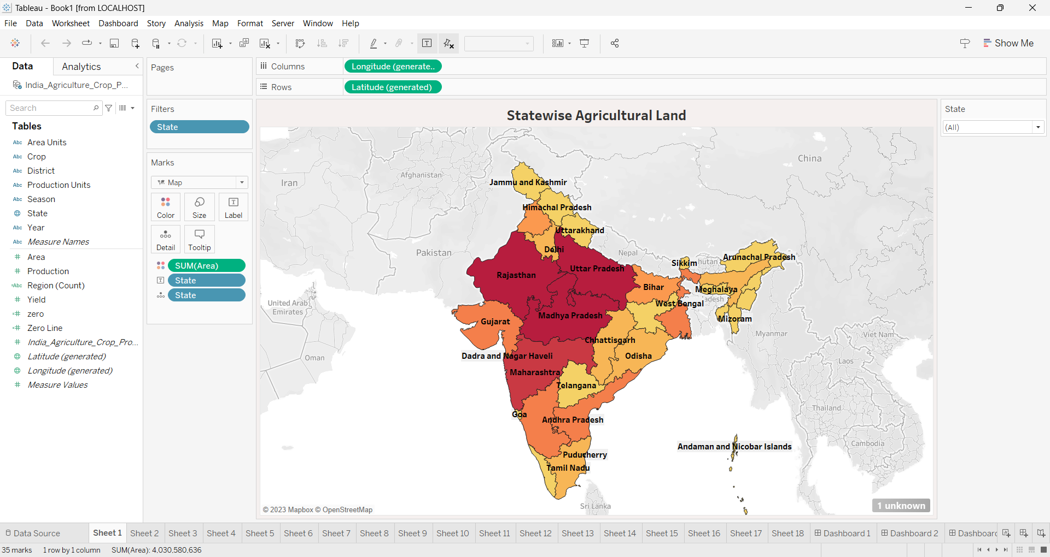
State wise agricultural land

Slide 9
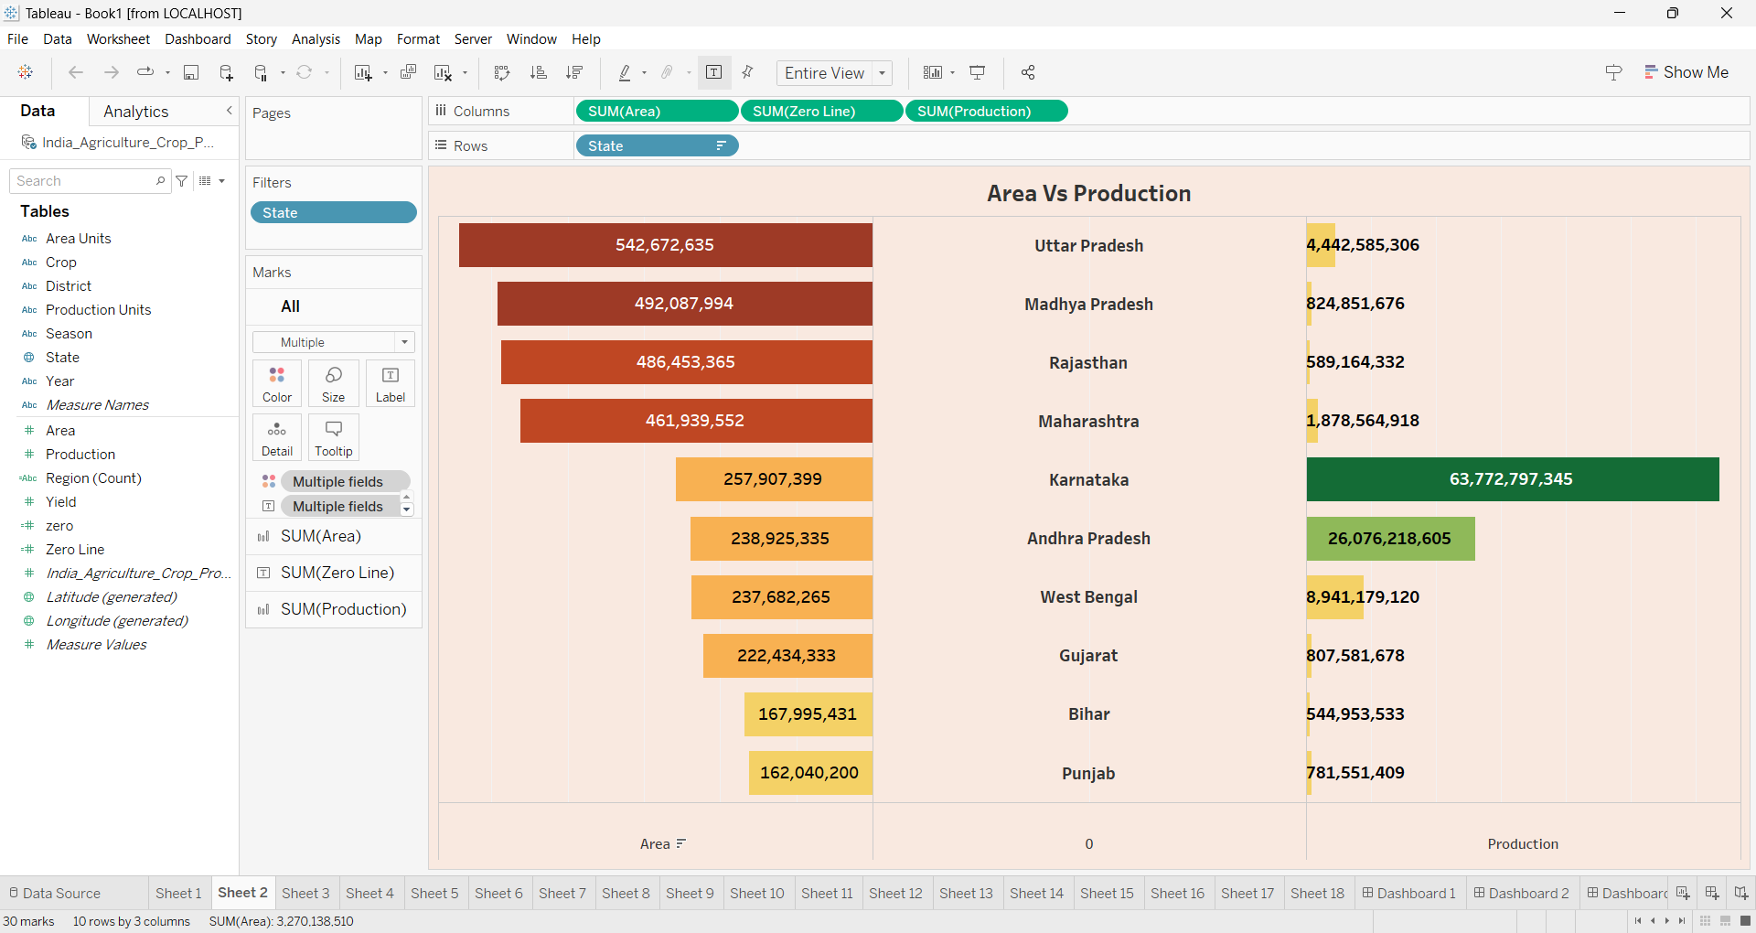
AREA VS PRODUCTION

Slide 10
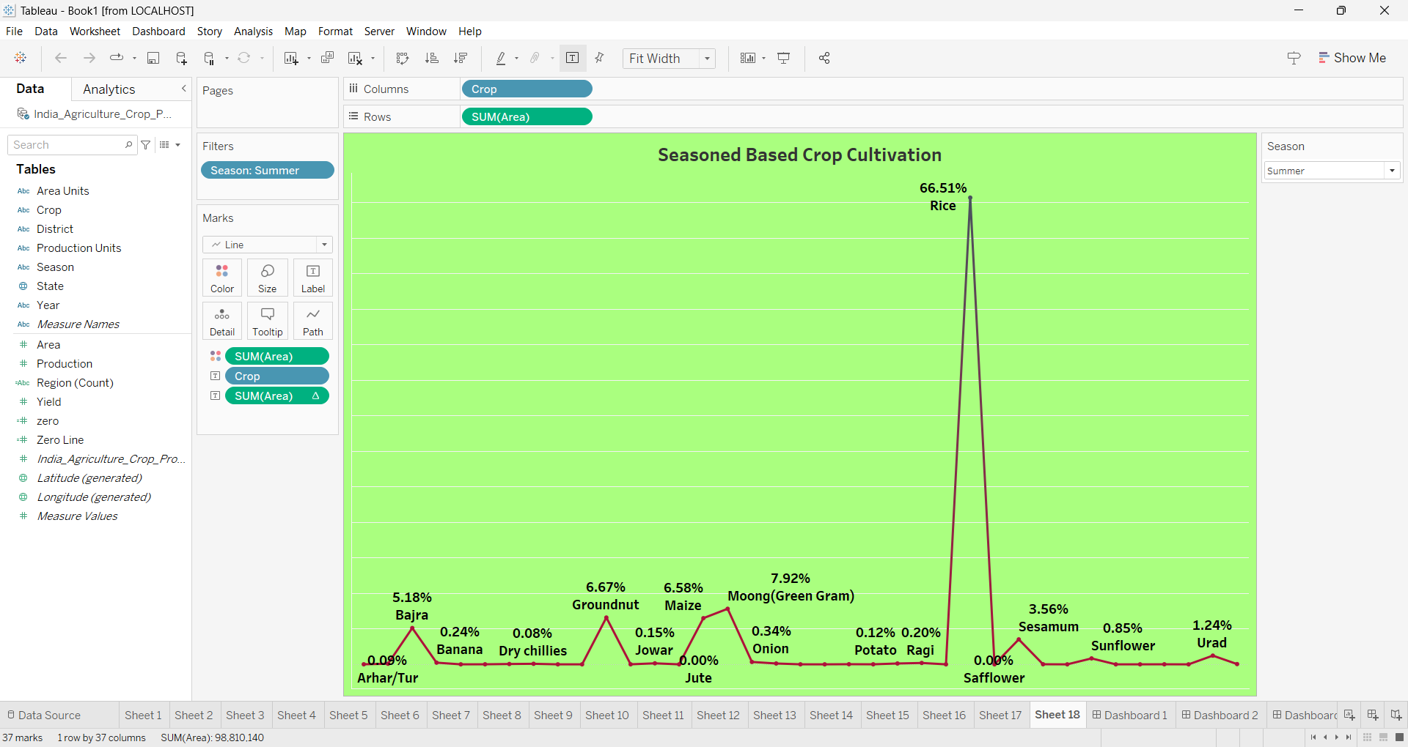
SEASON BASED CULTIVATION AREA

Slide 11
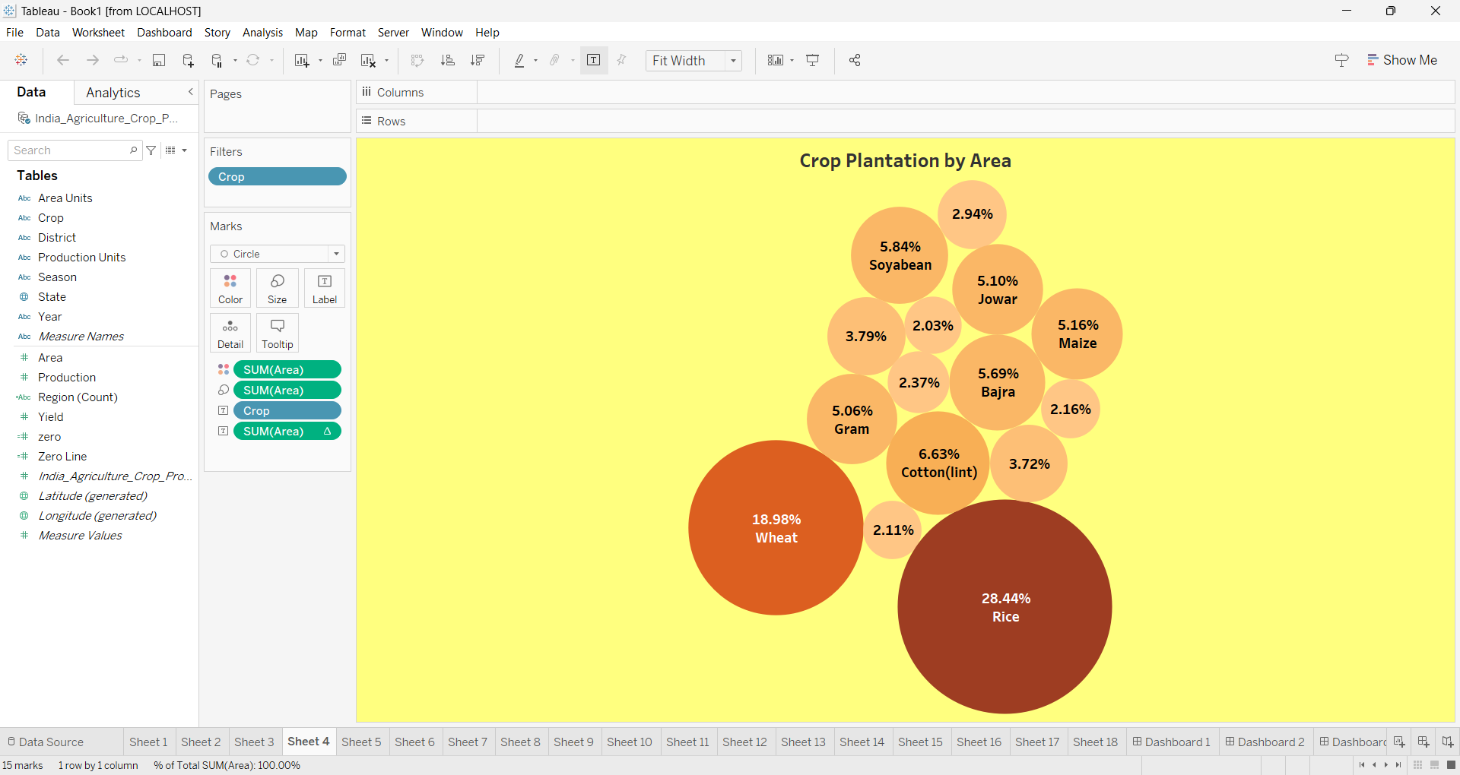
CROP PLANTATION BY AREA

Slide 12
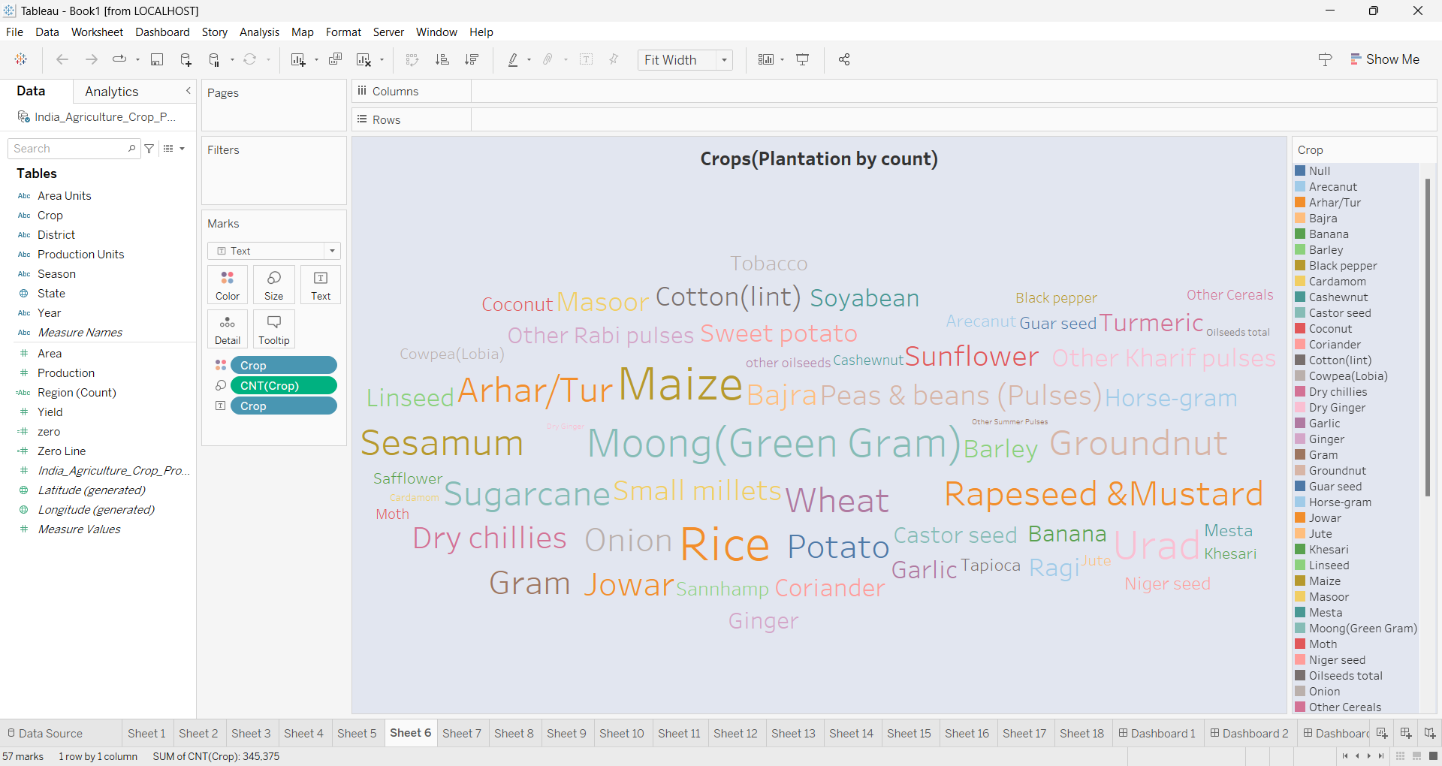
CROP (PLANTATION BY COUNT)

Slide 13
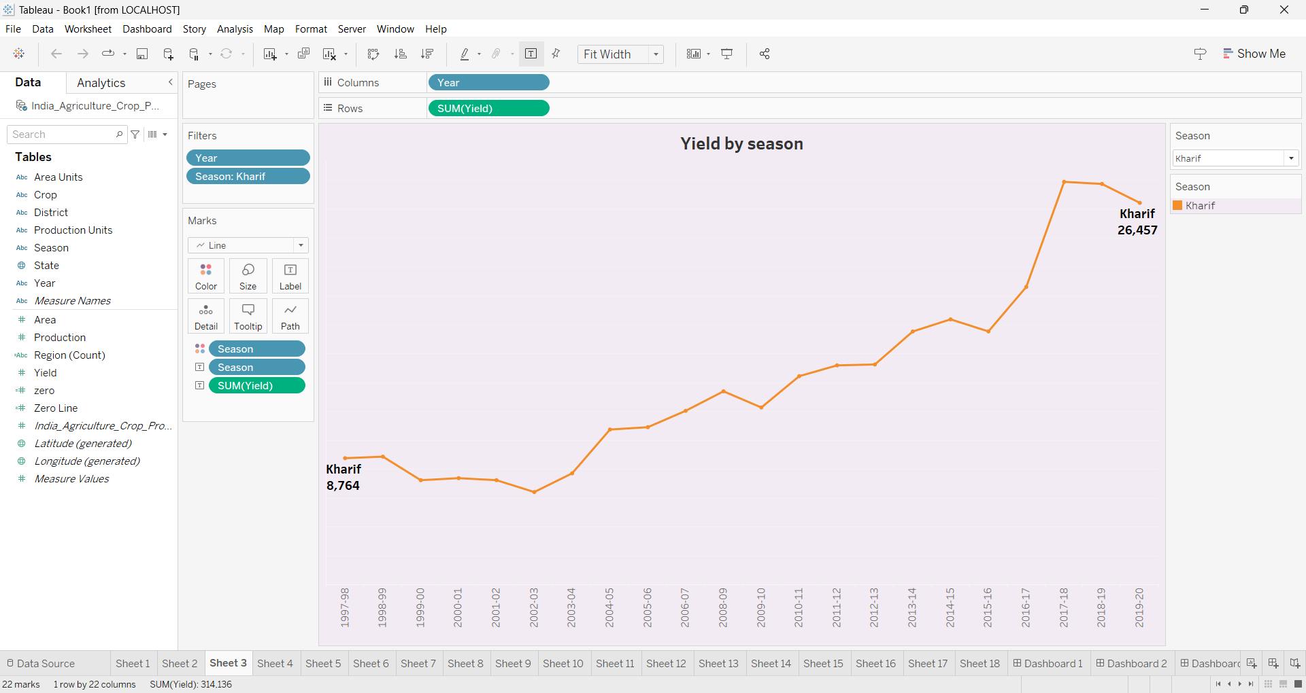
YIELD BY SEASON

Slide 14
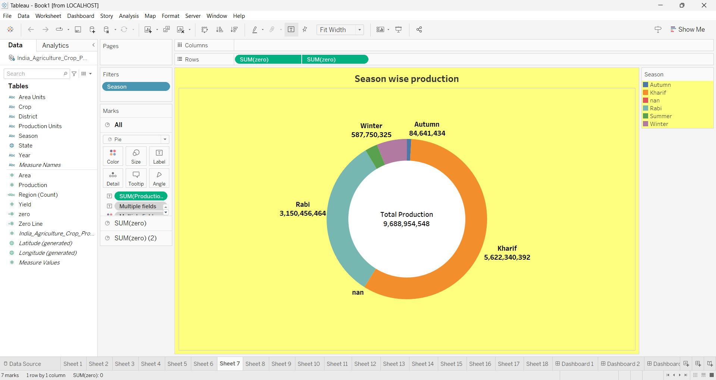
SEASON WISE PRODUCTION

Slide 15
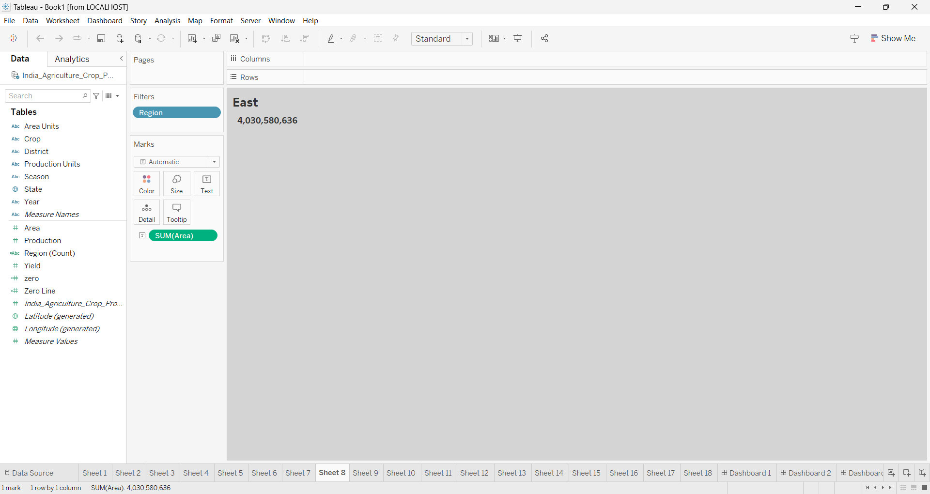
EAST

Slide 16
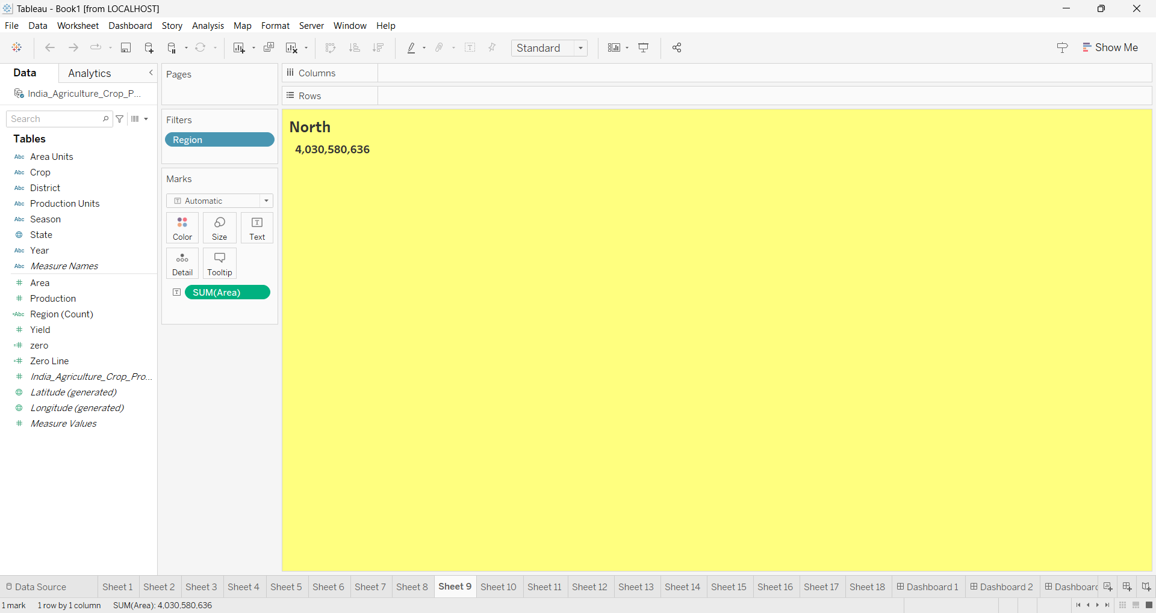
NORTH

Slide 17
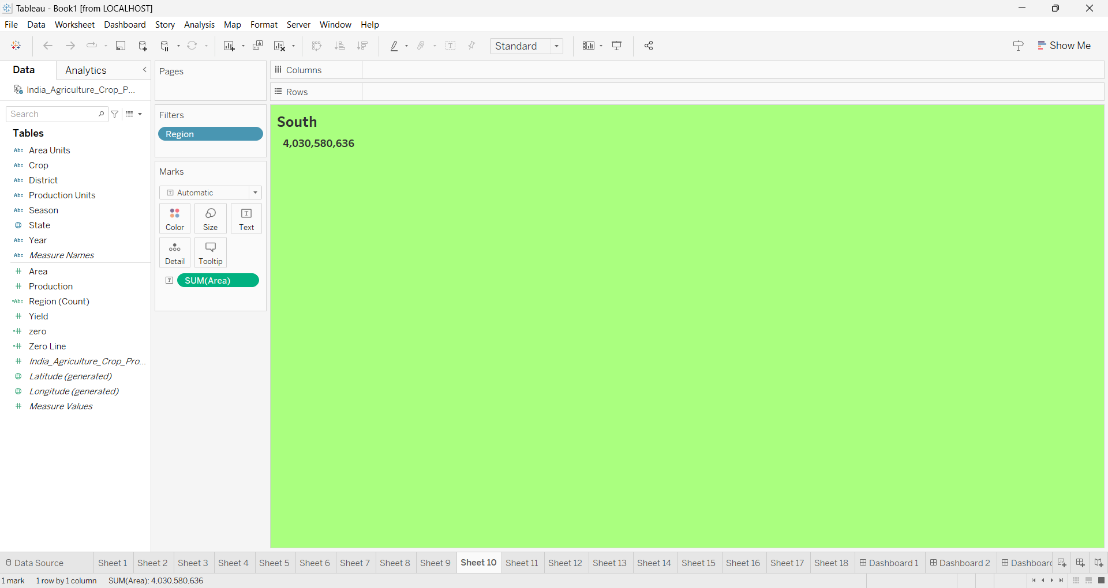
SOUTH

Slide 18
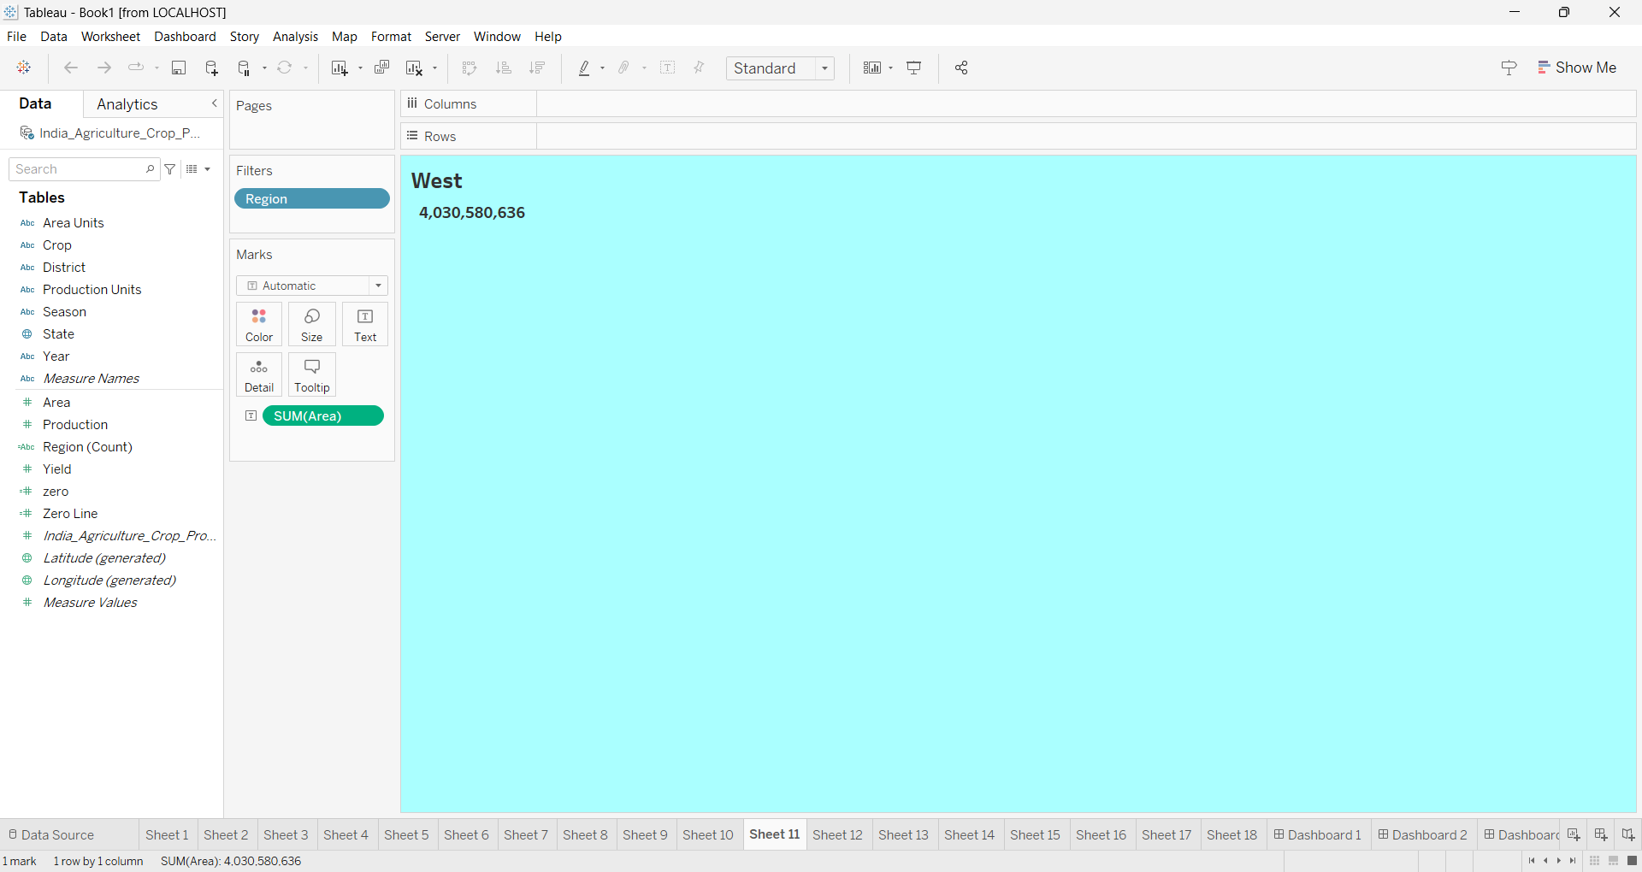
WEST

Slide 19
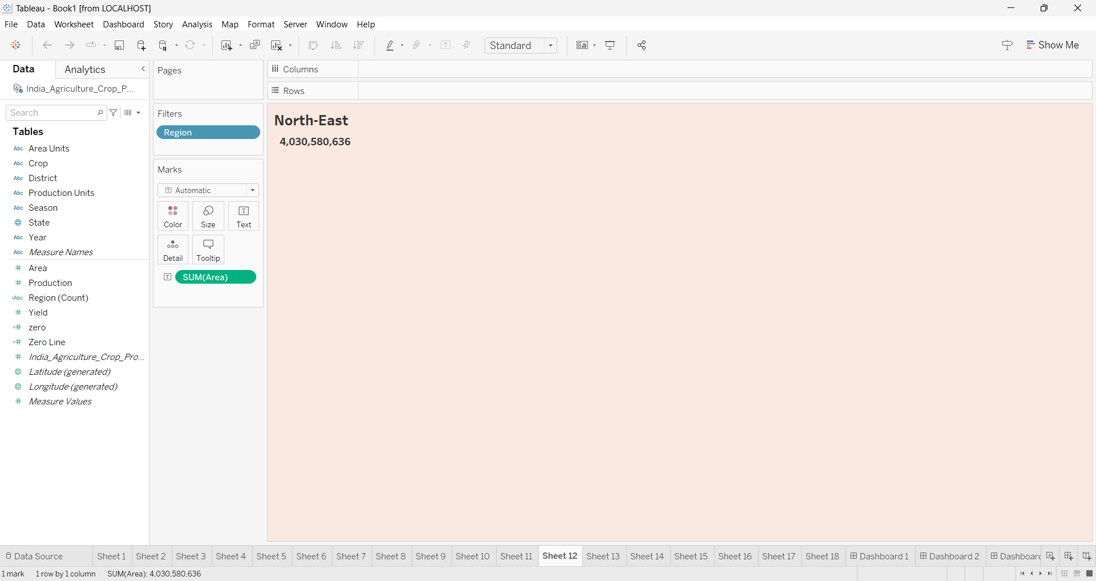
NORTH-EAST

Slide 20
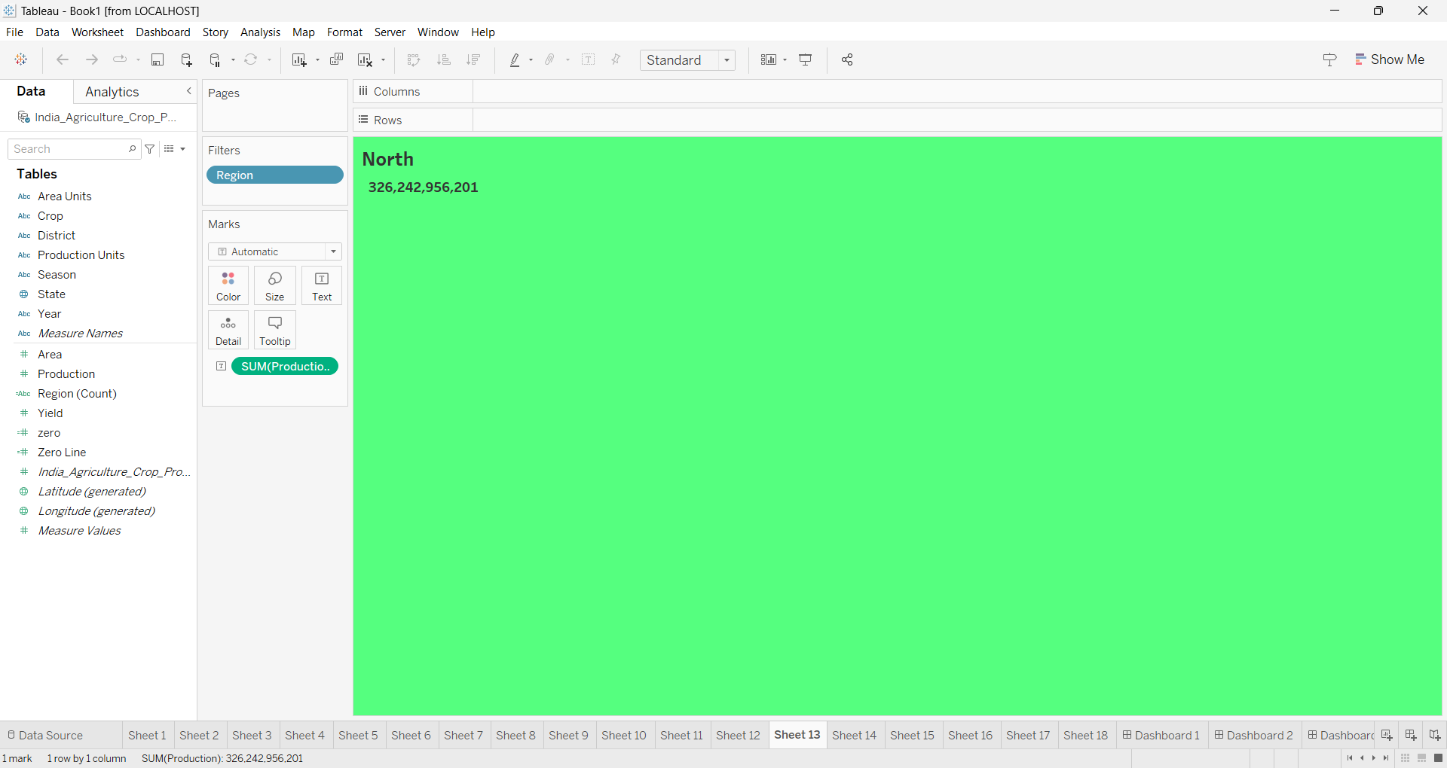
NORTH

Slide 21
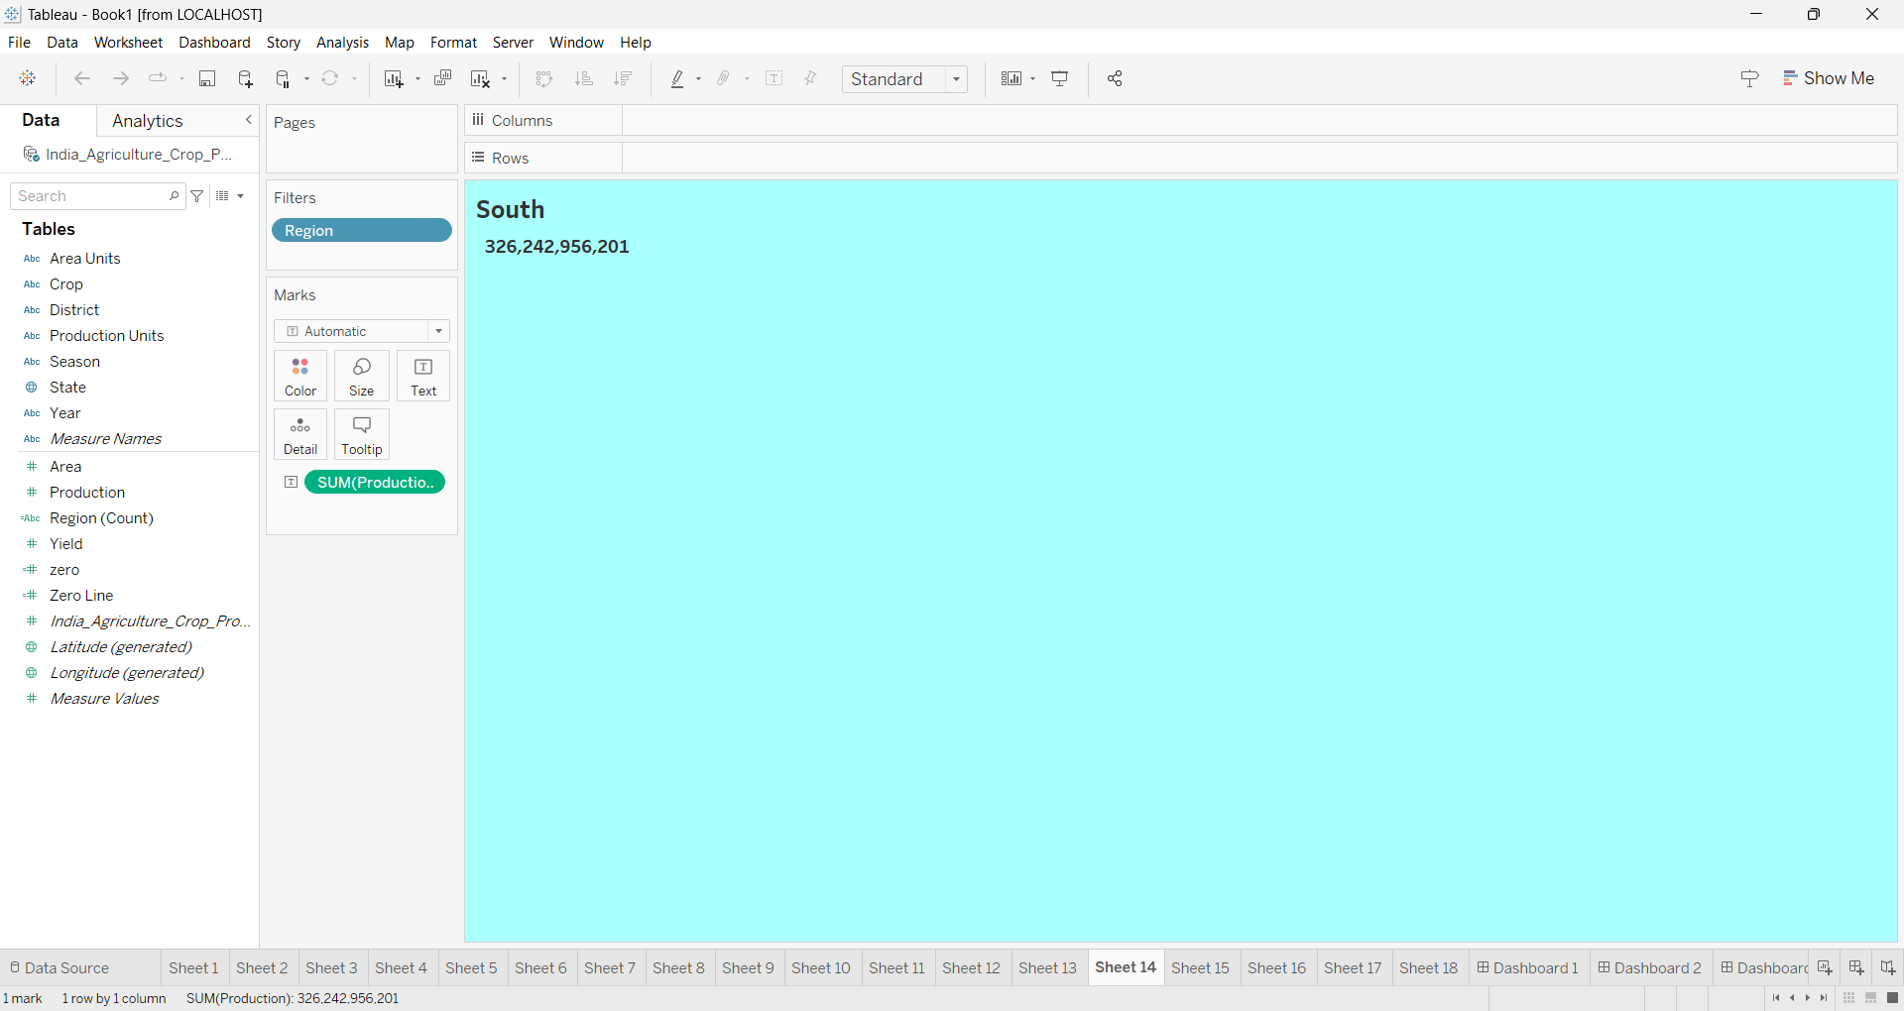
SOUTH

Slide 22
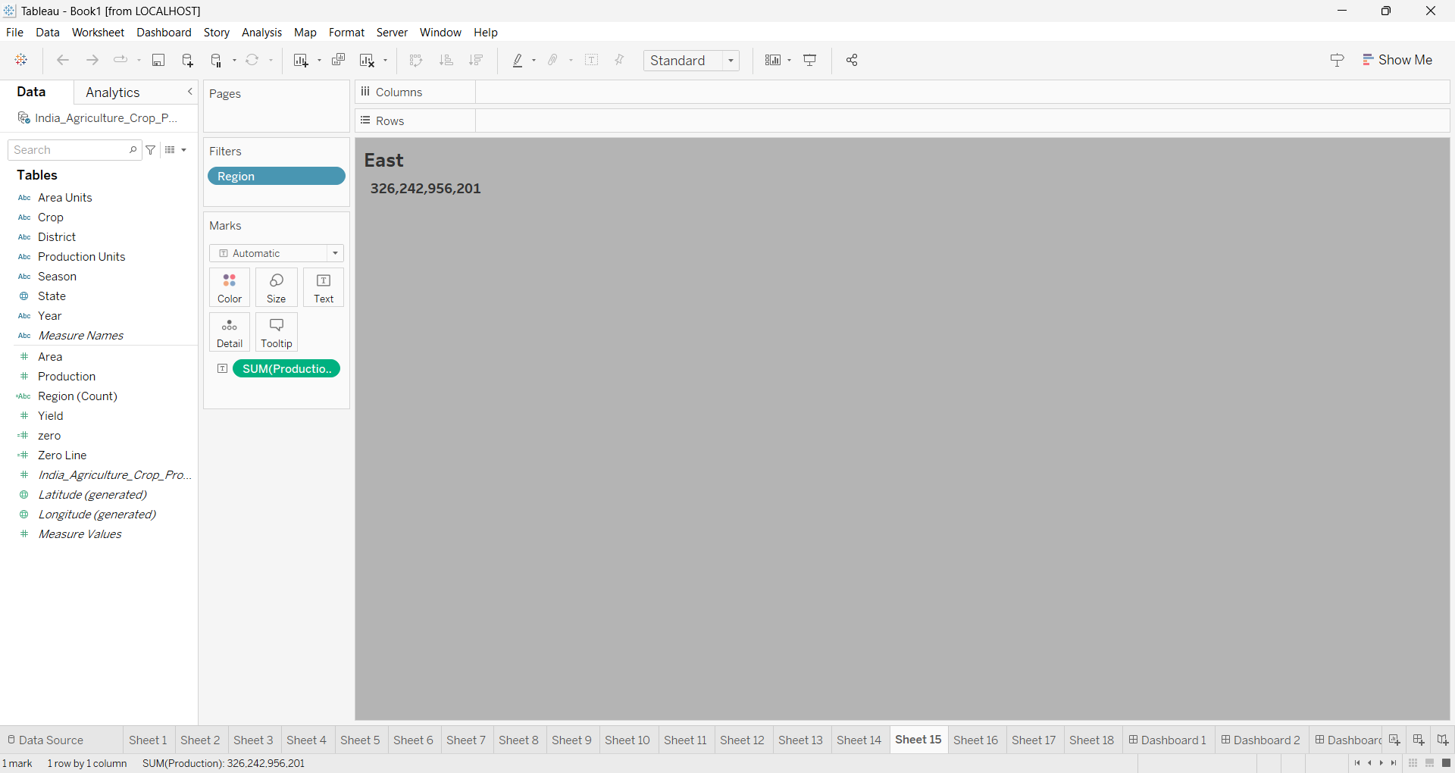
EAST

Slide 23
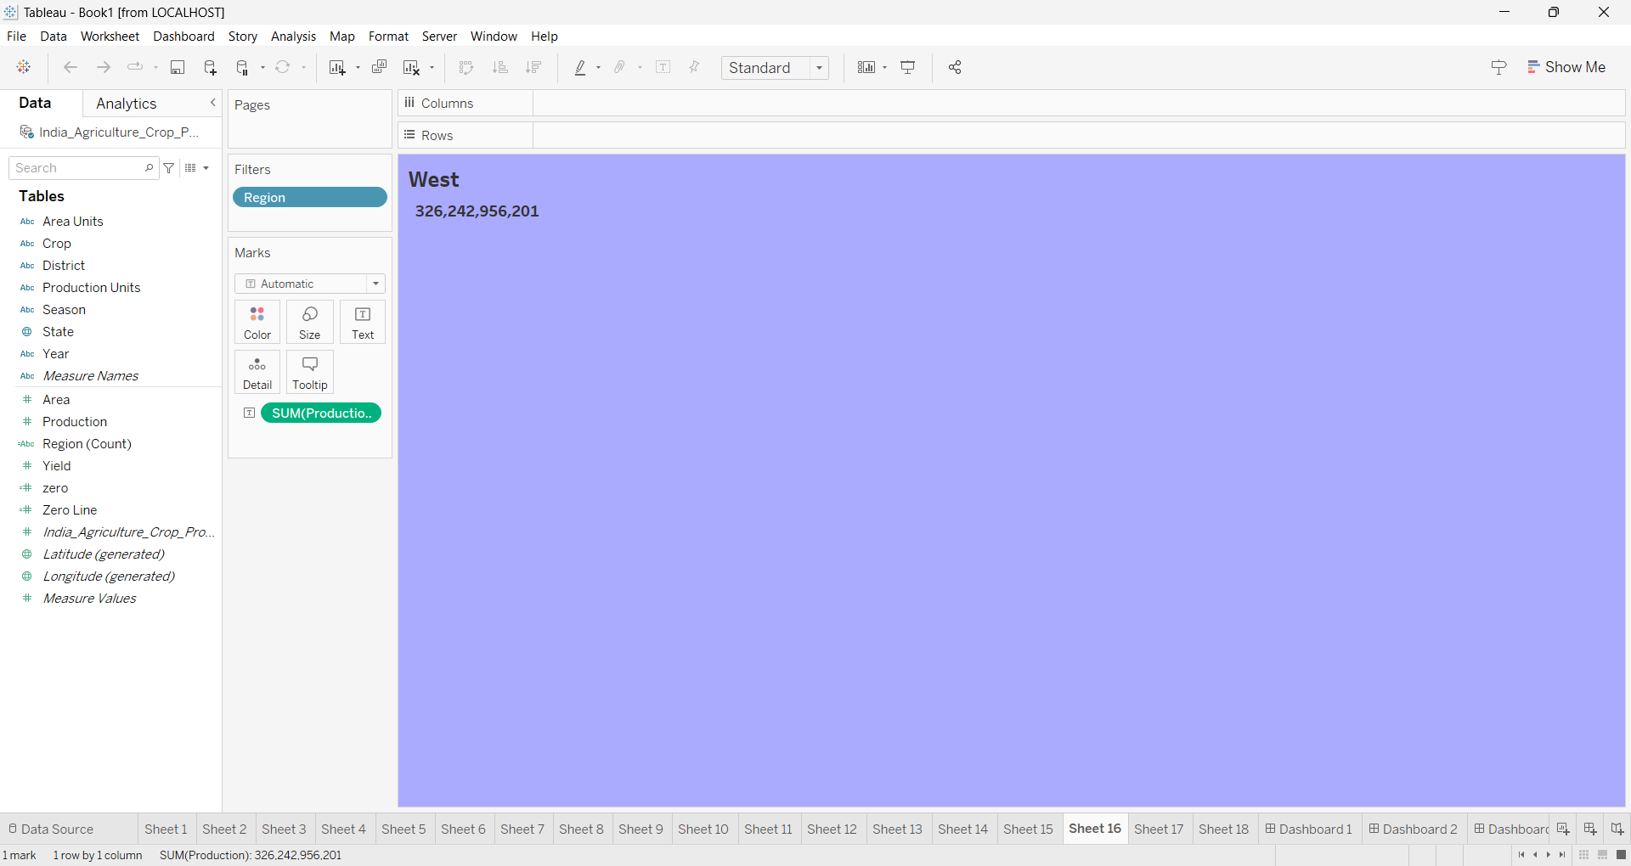
WEST

Slide 24
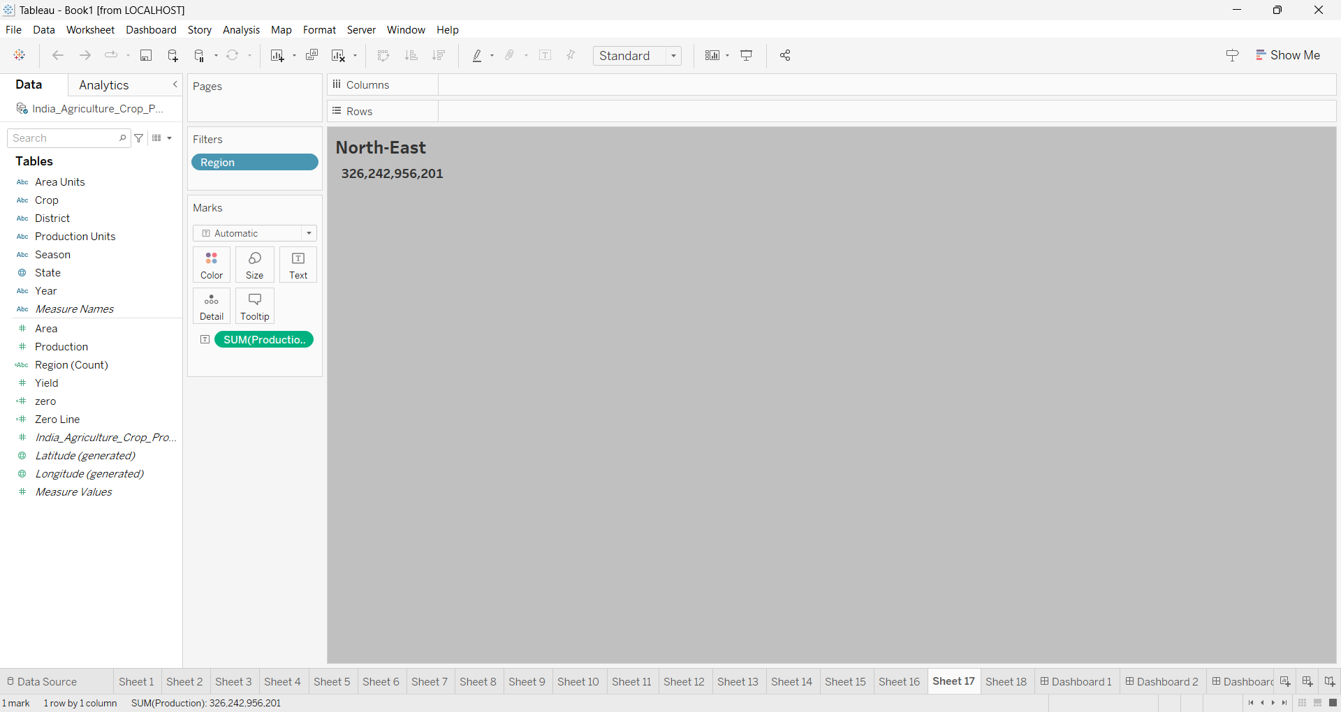
NORTH-EAST

Slide 25
DASH BOARD

Slide 26
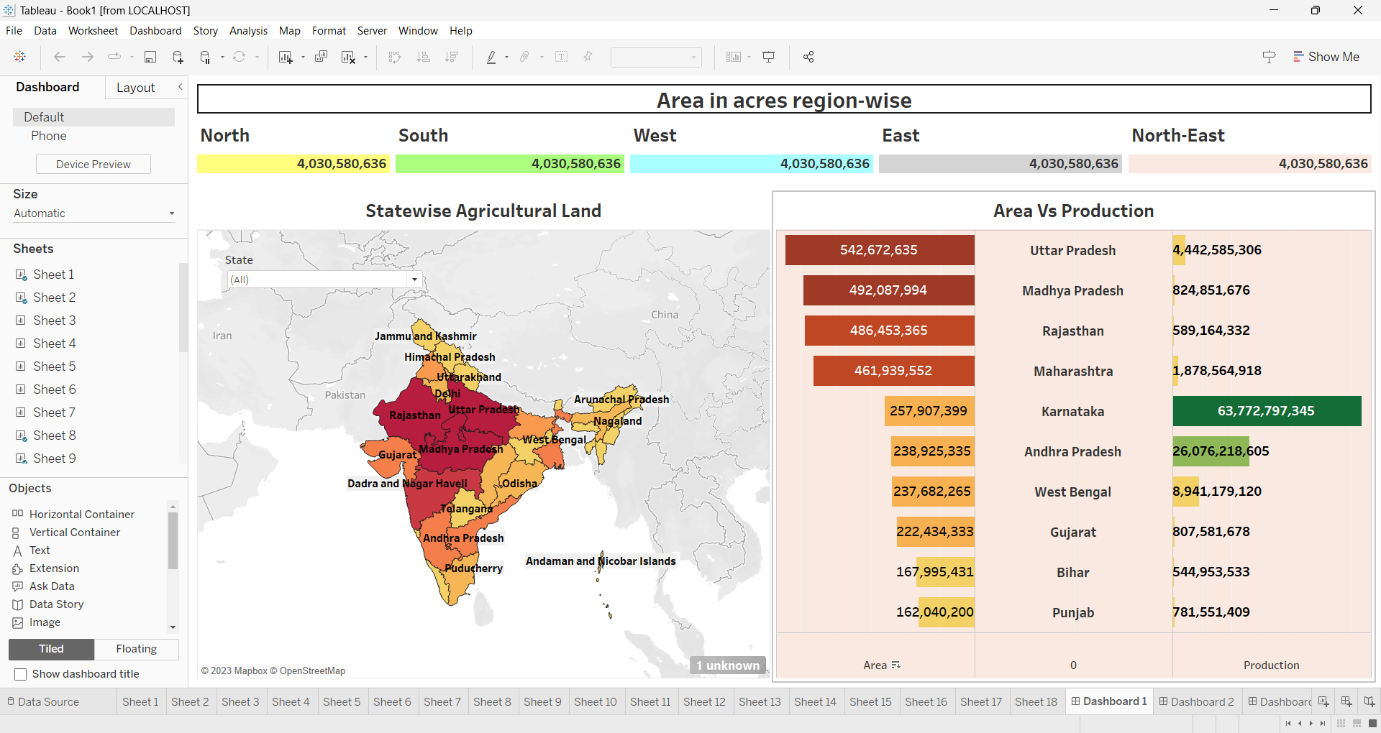

Slide 27
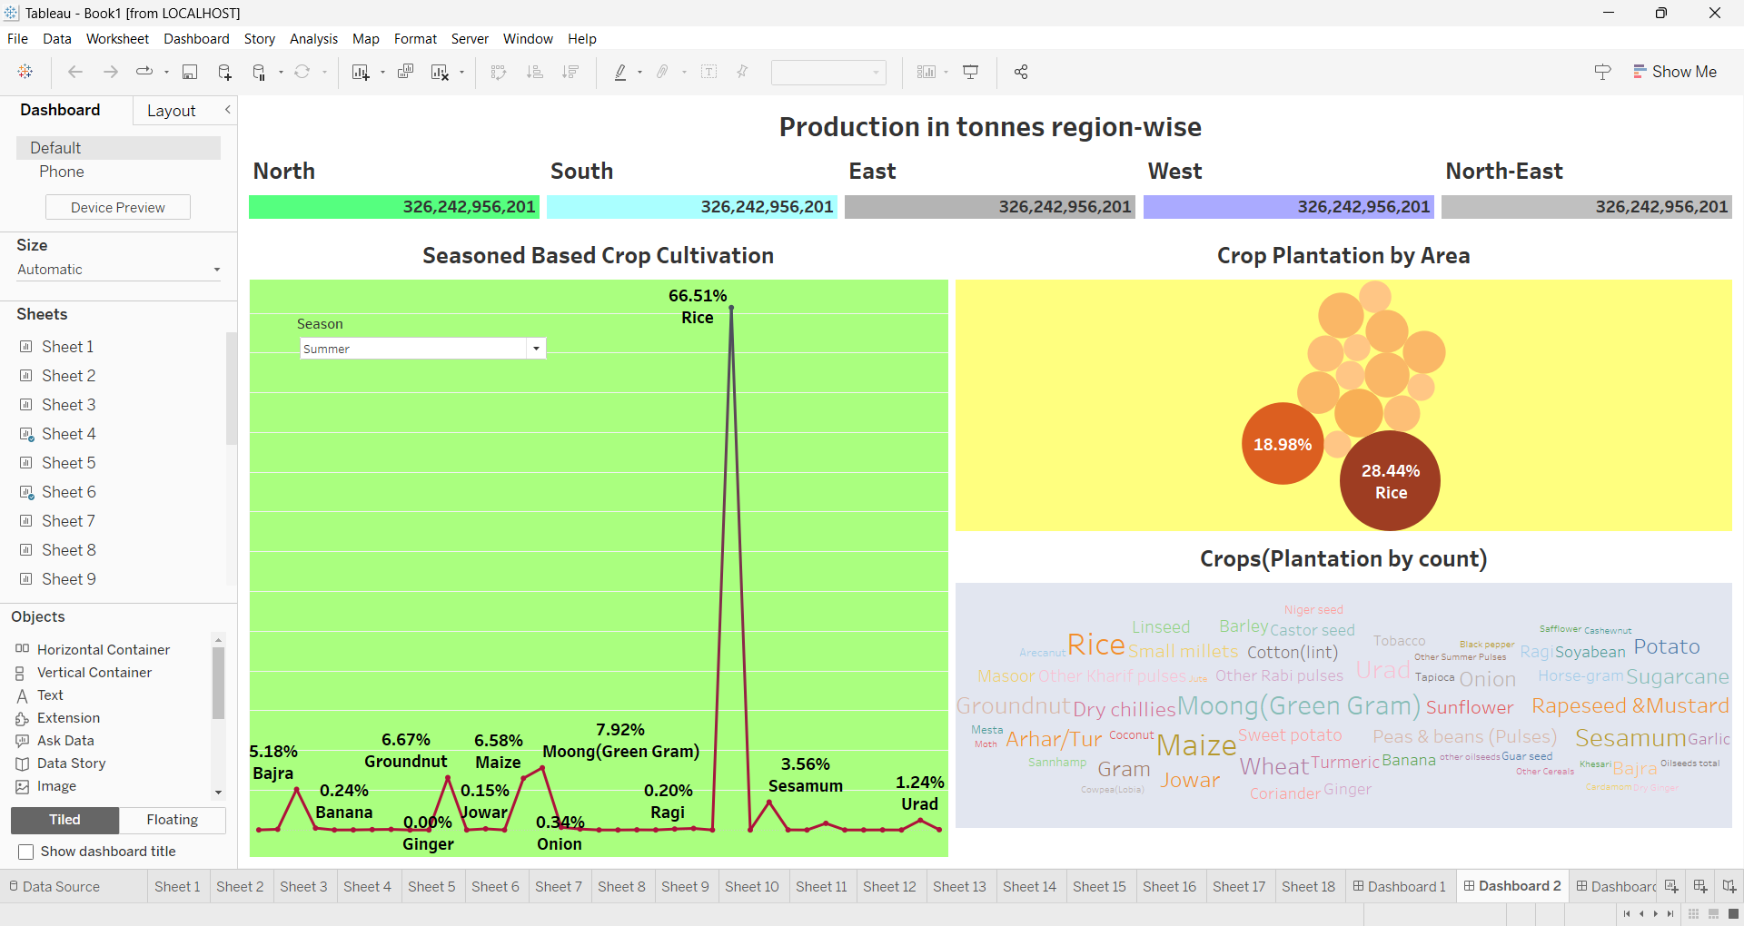

Slide 28
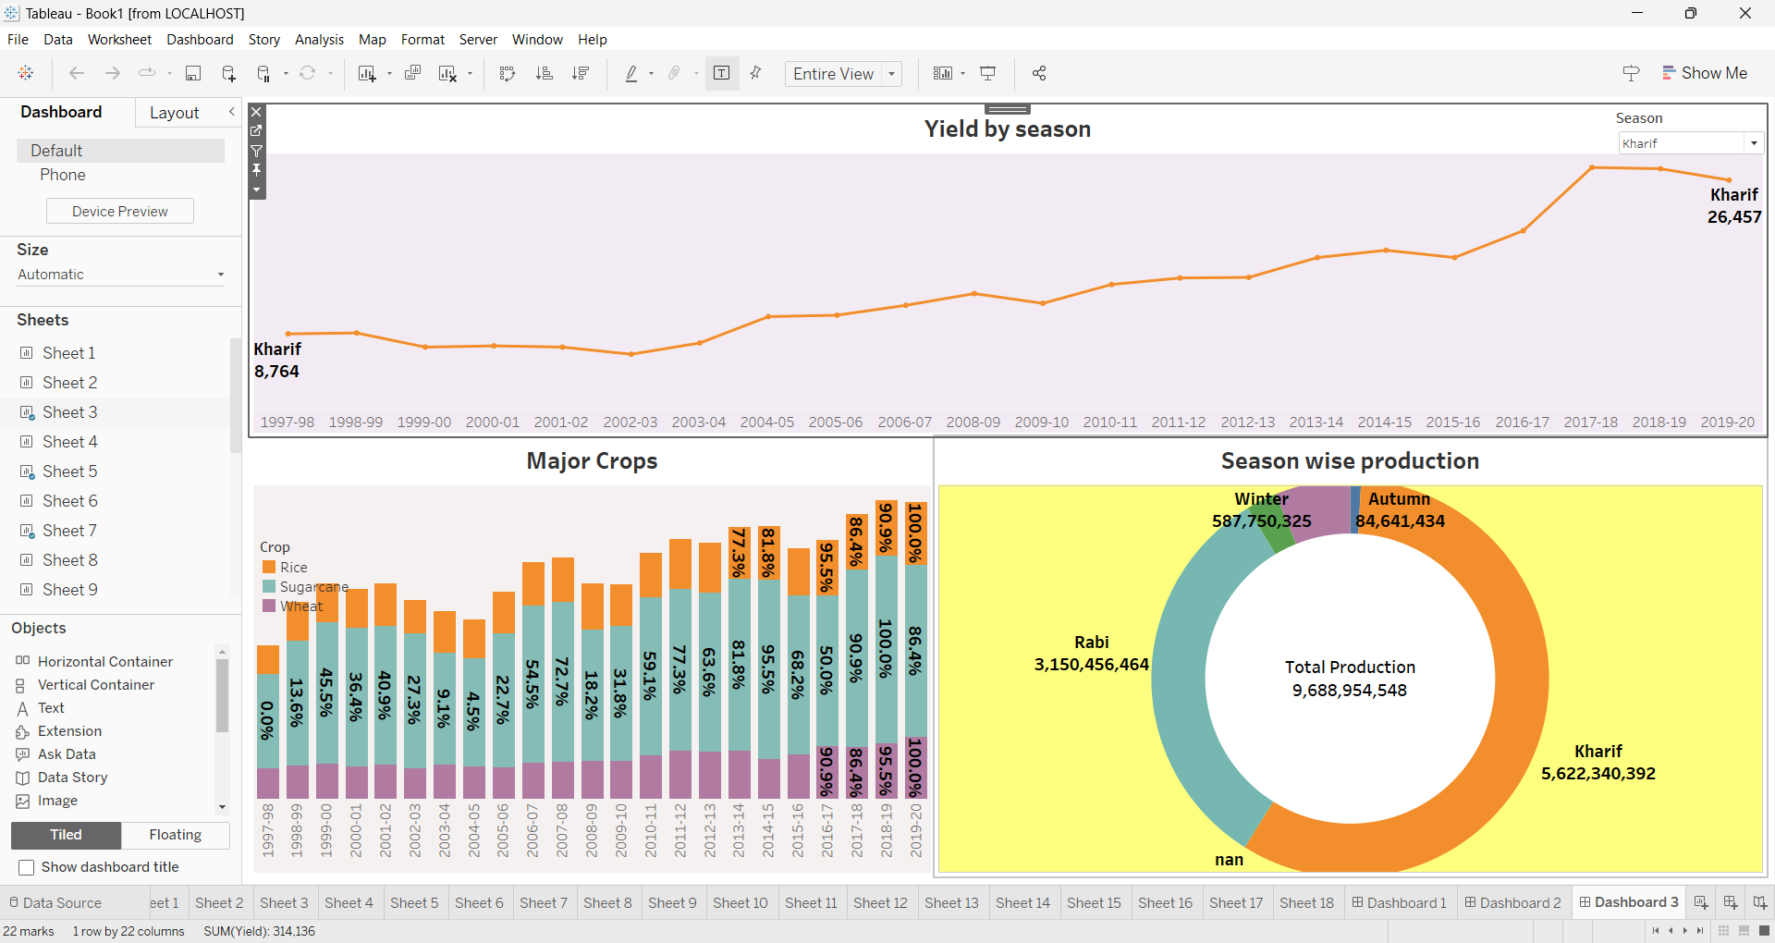

Slide 29
STORY

Slide 30
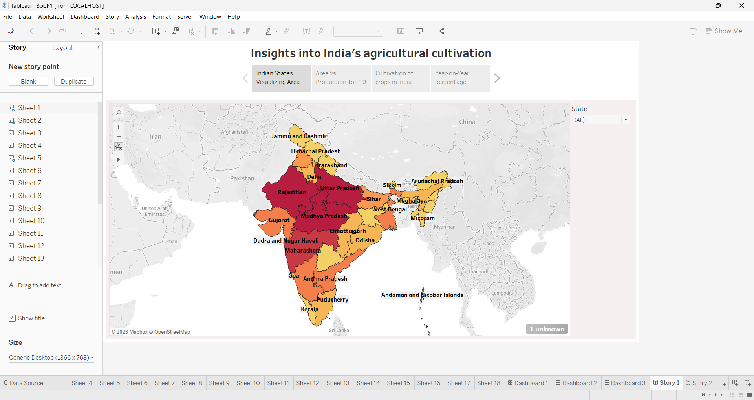

Slide 31
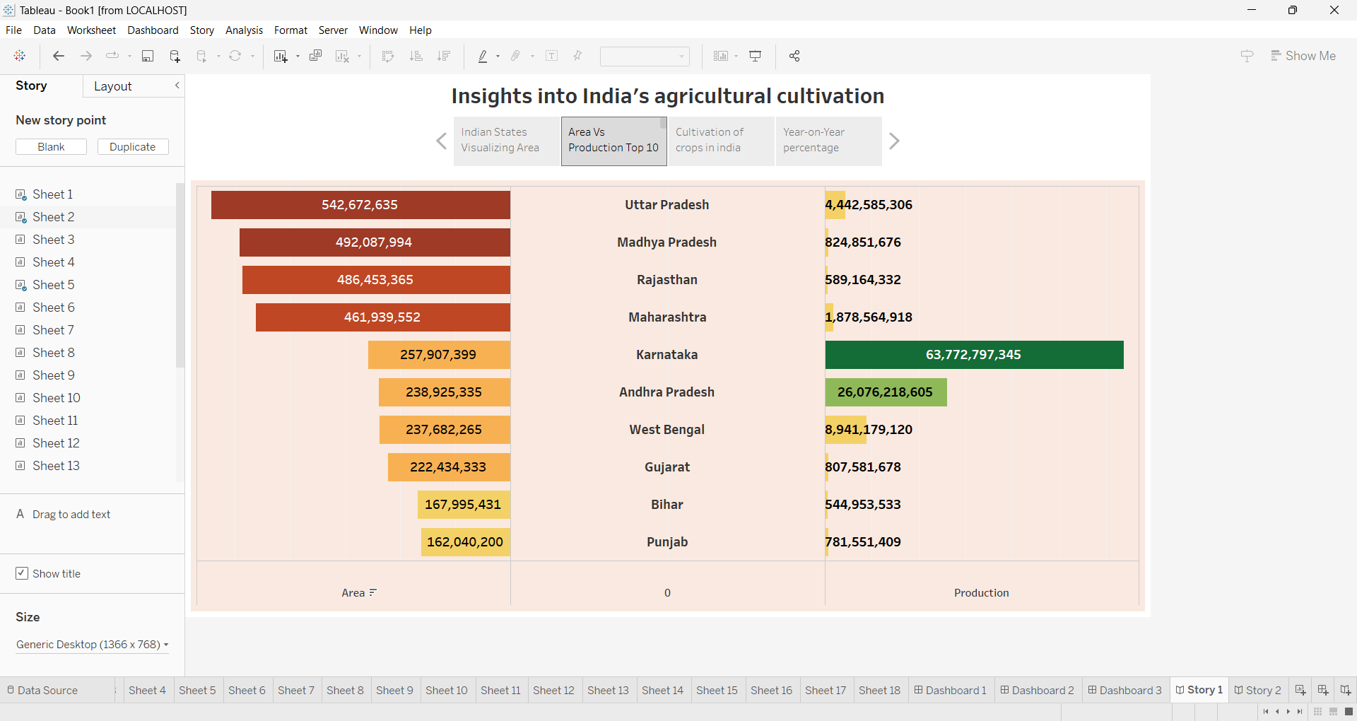

Slide 32
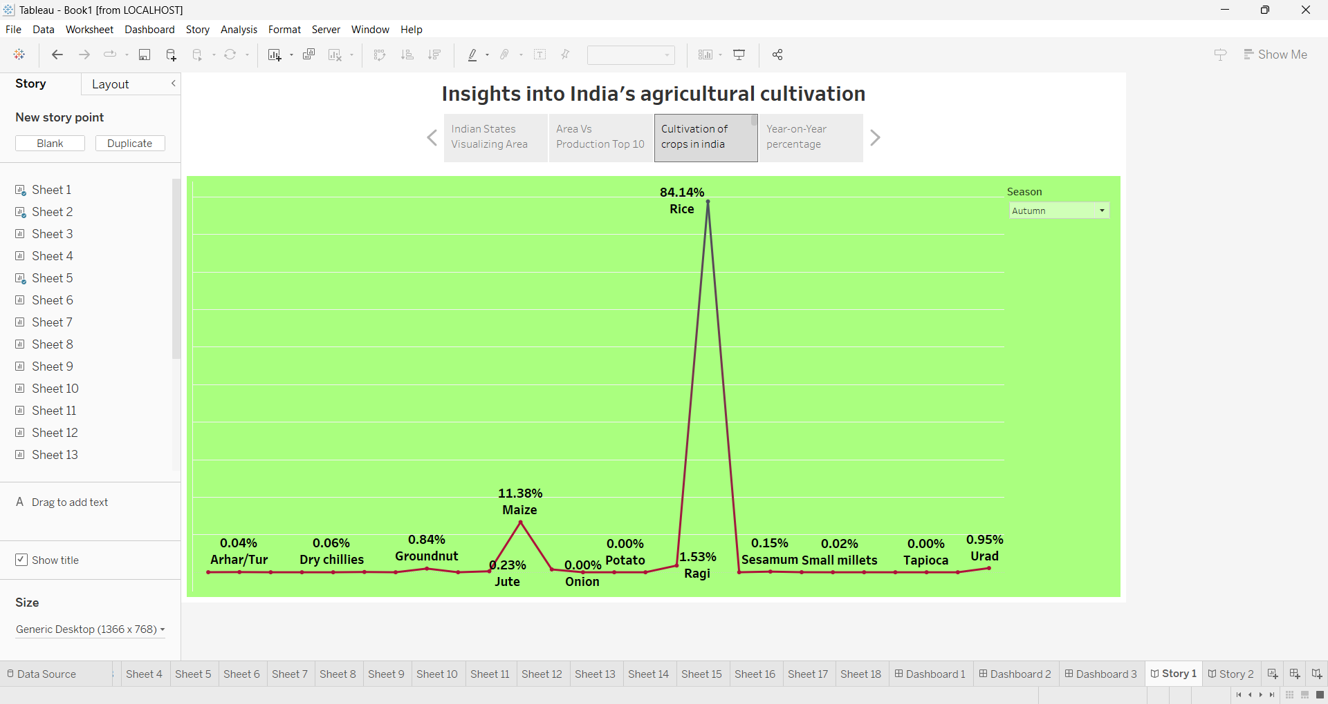

Slide 33
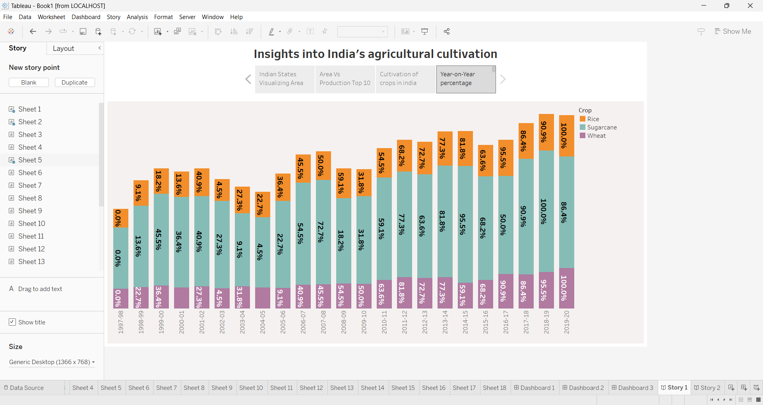

Slide 34
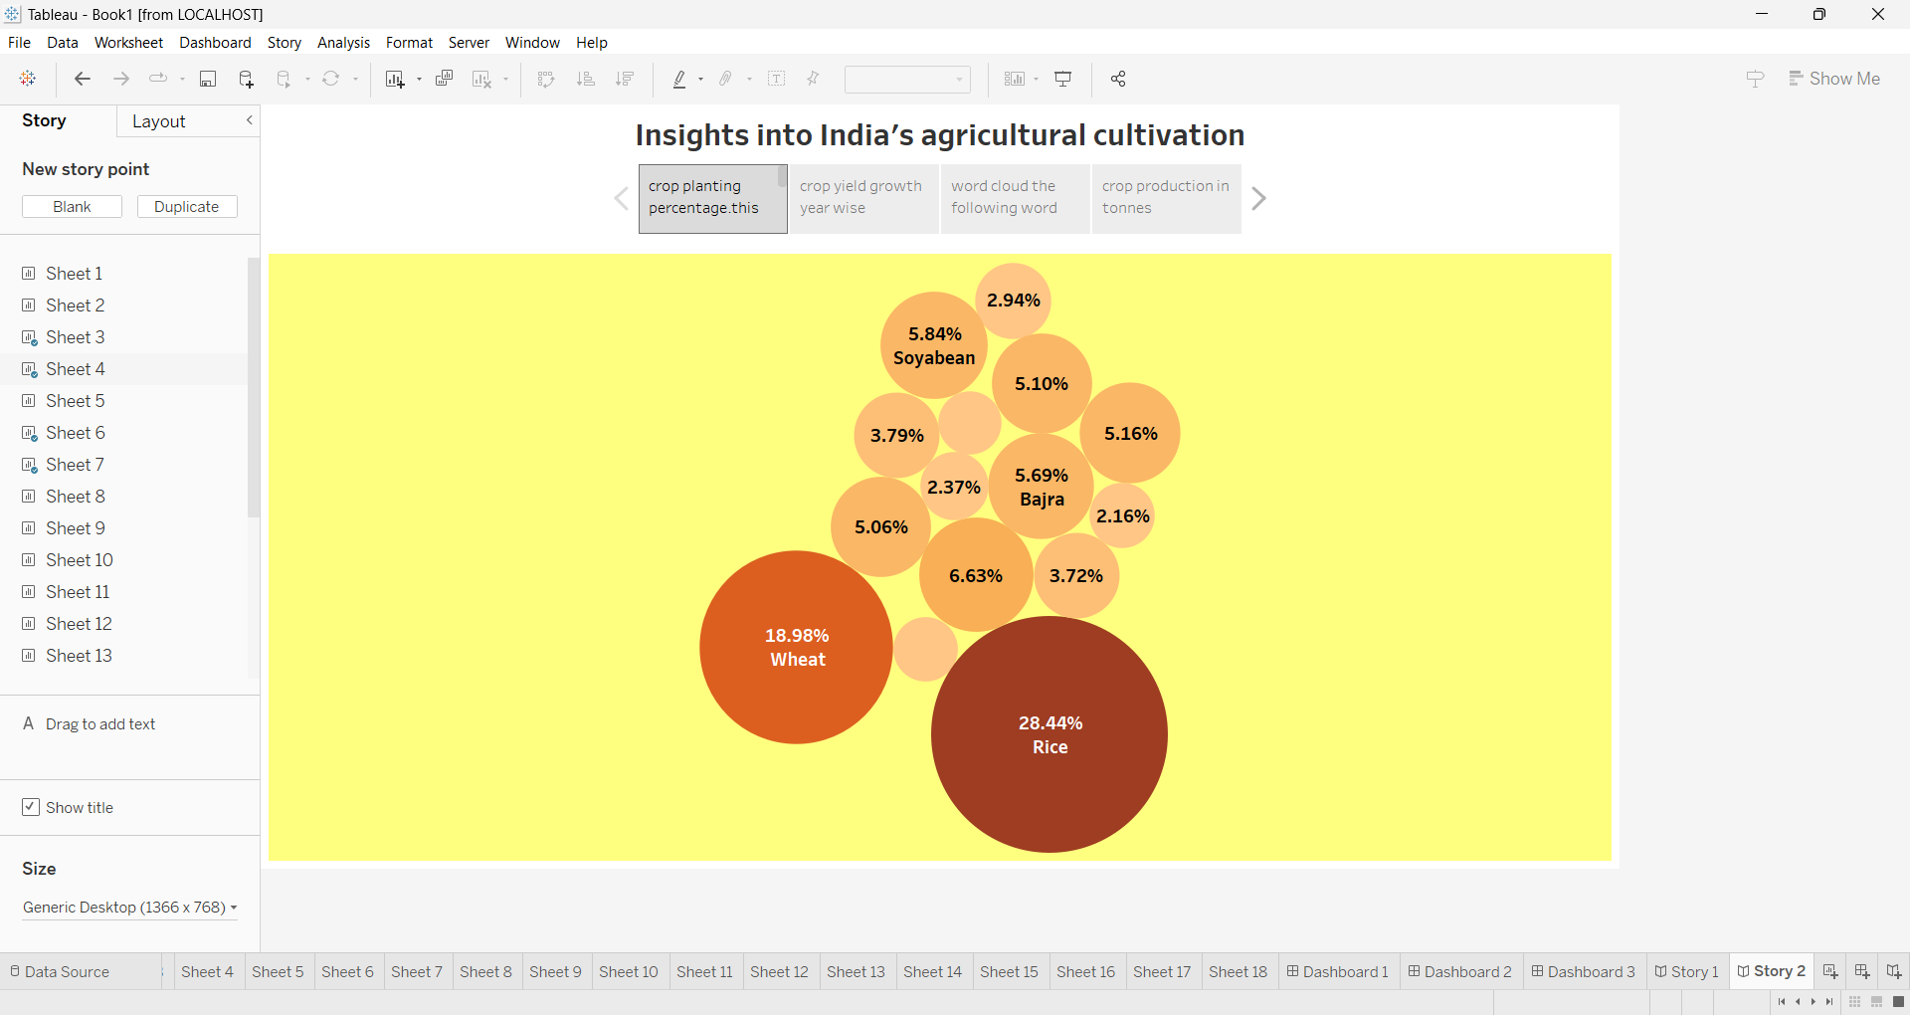

Slide 35
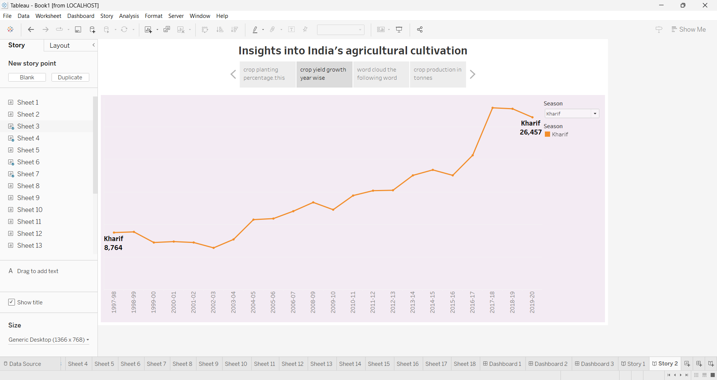

Slide 36
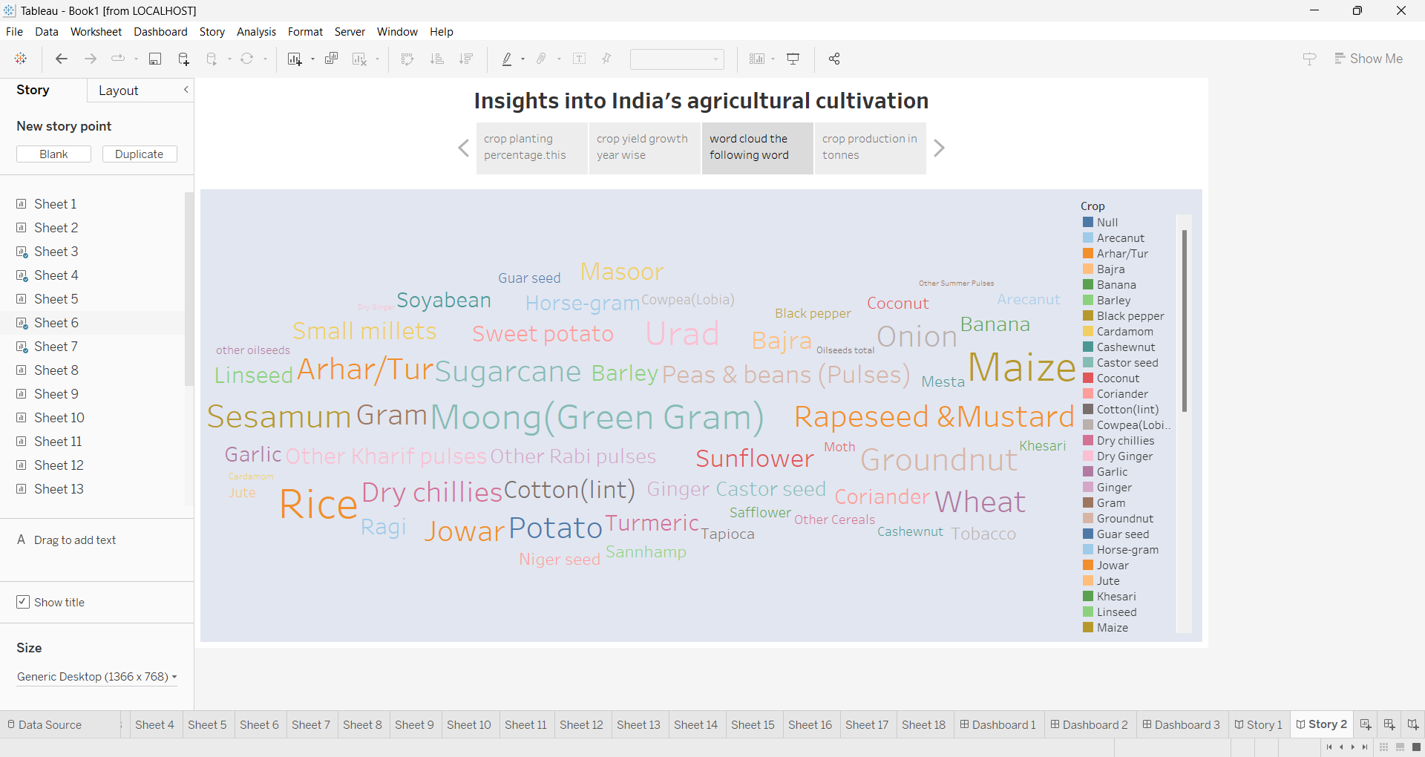

Slide 37
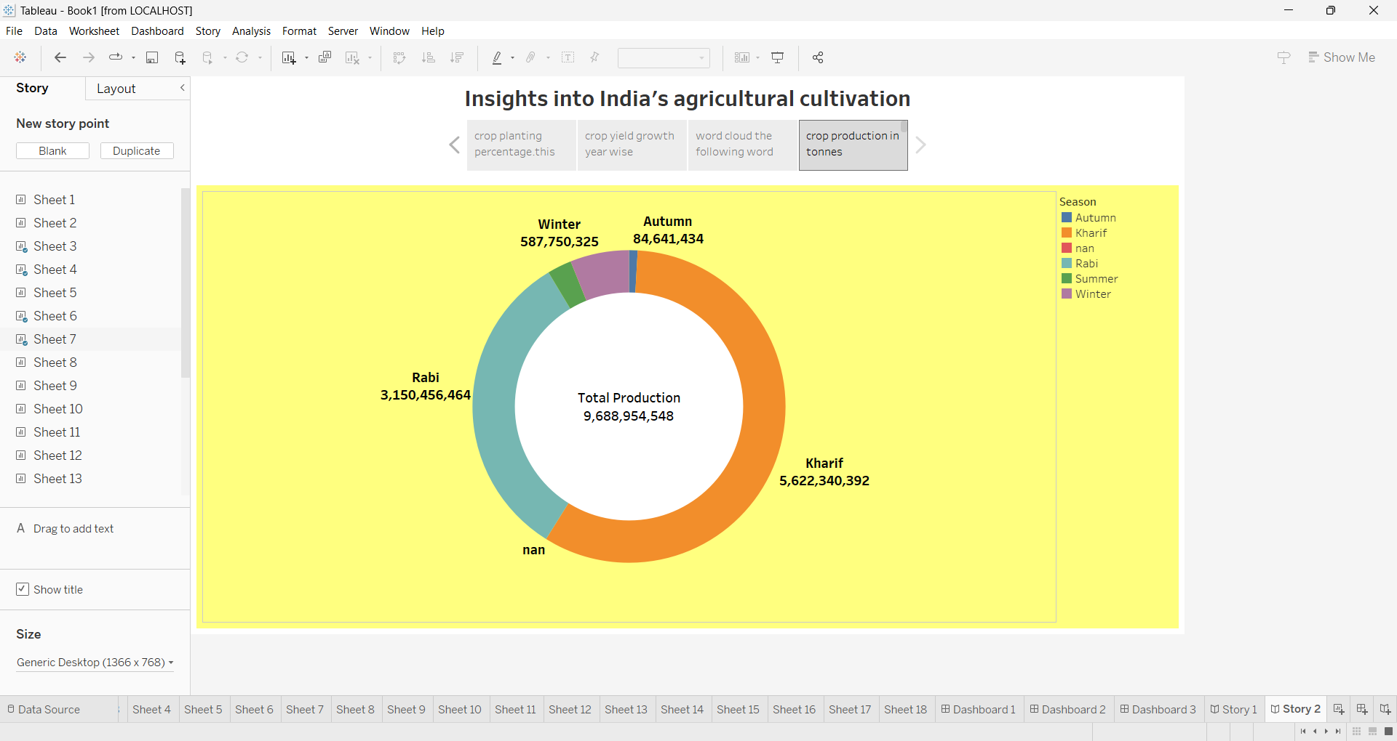

Slide 38
publishing

Slide 39
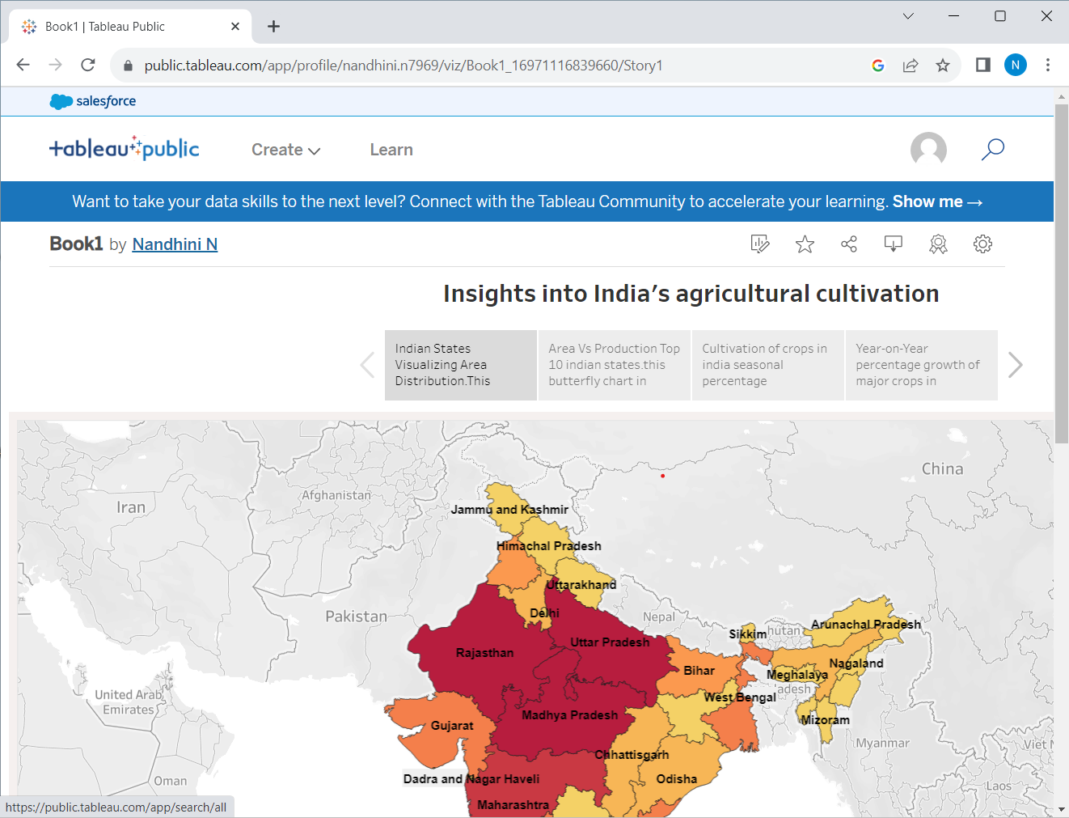

Slide 40
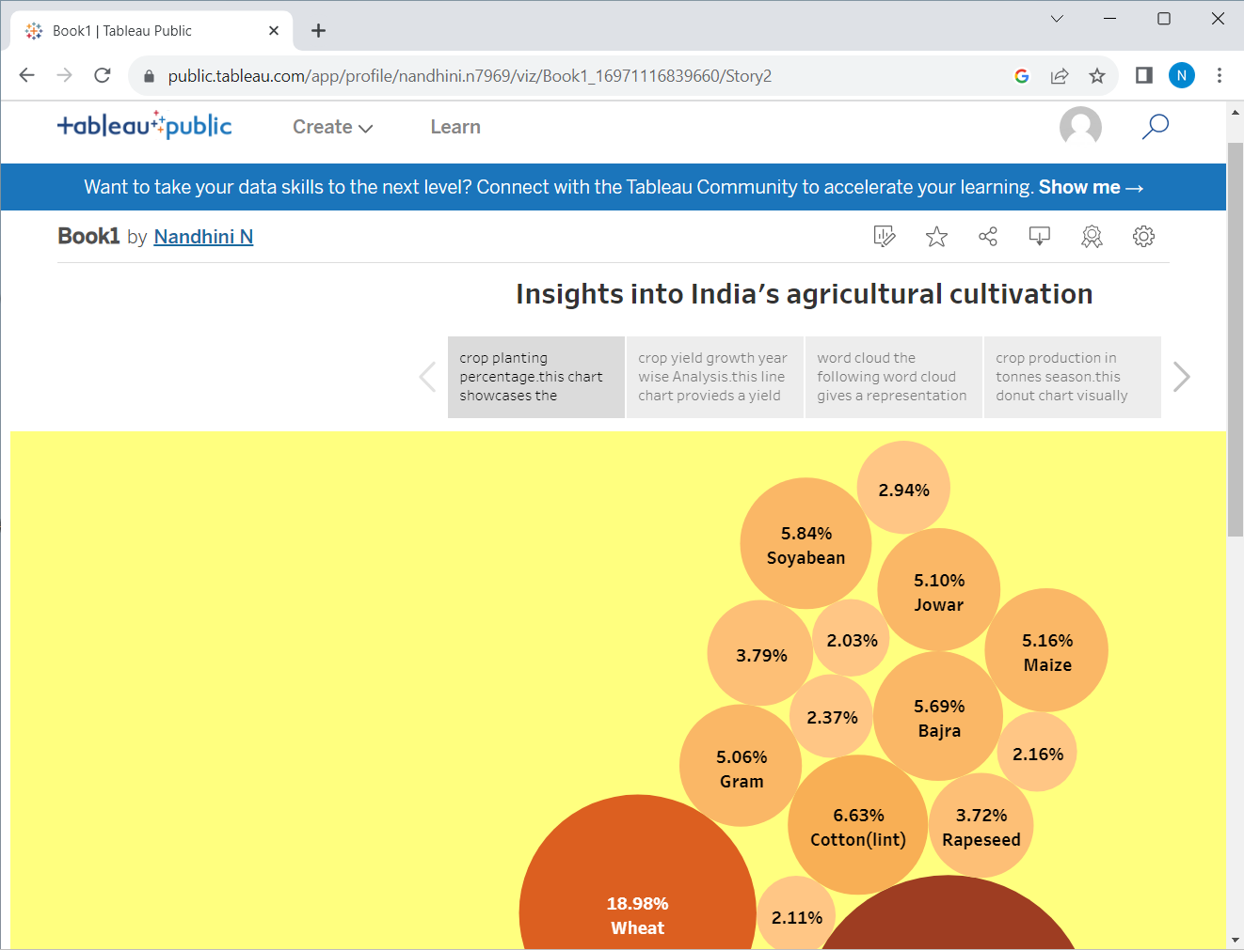

Slide 41
Advantages and disadvantages
It is useful to know about the field of agriculture.
This project is very useful to analysis the agricultural cultivation during the year of 1997-2021.
Time duration is the most common problem of this project.

Slide 42
applications:
Tableau is an excellent tool for managing large datasets . It may be used for data collection ,analysis ,and visualization.
The greater number of variables, the easier it to comprehend and make predictions.

Slide 43
Conclusion:
Finally the processes which have been done by our team is published on tableau the video of our project is demonstrated . The project report I given above . We have a clear dashboards and story which are to be easily understood.

Slide 44
Future scope:
This project gave as a guidance to get a job later to this field in our future in a software companies. We may be analysis in our life

Slide 45
THANK YOU

